Slide 1
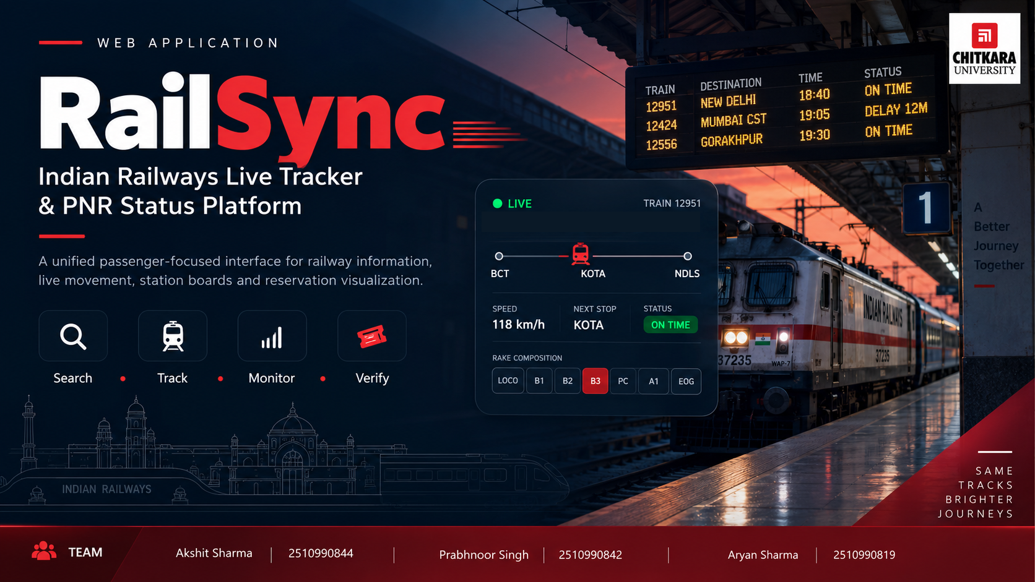
WEB APPLICATION
RailSync
Indian Railways Live Tracker
& PNR Status Platform
A passenger-focused railway information experience for search, live movement, station boards and reservation visualization.
PROJECT TEAM
Akshit Sharma · 2510990844
Prabhnoor Singh · 2510990842
Aryan Sharma · 2510990819

Slide 2

01 • INTRODUCTION
What is RailSync?
One interface that brings the most useful railway information into a clear, modern workflow.
Unified Passenger Experience
Railway-Inspired UI
Built for Interaction
RailSync reduces the need to jump between separate screens for train search, live tracking, station movements and PNR information.
The visual language uses platform boards, signal colors, route ribbons and coach layouts to make information immediately recognizable.
The project is not a static website: React components update views, state and railway data without reloading the entire interface.
AKSHIT SHARMA • 2510990844 | PRABHNOOR SINGH • 2510990842 | ARYAN SHARMA • 2510990819

Slide 3
02 • PROBLEM STATEMENT
The passenger information problem
Railway data is useful only when users can find, understand and act on it quickly.
Fragmented information
Hard-to-read status
Train search, live status, station boards and PNR details often feel disconnected.
Raw tables and text make delays, route progress and coach information difficult to scan.
Poor journey context
Limited continuity
Passengers need “where is my train?”, “what is next?” and “where is my berth?” in visual form.
Without persistent storage, user preferences and journey history are not retained across sessions.
AKSHIT SHARMA • 2510990844 | PRABHNOOR SINGH • 2510990842 | ARYAN SHARMA • 2510990819

Slide 4
03 • OUR SOLUTION
One journey. Four connected modules.
RailSync organizes the passenger workflow from discovery to live journey monitoring.
01
02
03
04
SEARCH
→
TRACK
→
MONITOR
→
VERIFY
Find stations, routes and trains
View live route and movement
Check station arrivals/departures
View PNR and berth details
The result is a single passenger-focused dashboard instead of isolated information screens.
AKSHIT SHARMA • 2510990844 | PRABHNOOR SINGH • 2510990842 | ARYAN SHARMA • 2510990819

Slide 5
04 • KEY FEATURES
Designed around real railway tasks
The current build already covers the major passenger-facing flows.
Train & Station Search
Live Train Tracker
Station Live Board
Station autocomplete, origin/destination flow, hot routes and direct train-number lookup.
Route map, progress, speed, next stop, status indicators and train composition.
Arrivals/departures with time-window filters and one-click tracking.
PNR & Coach View
Signal-Based Status
Responsive Interface
PNR validation, berth allocation, coach sequence and visual compartment layout.
Green / amber / red visual cues make on-time and delay conditions easy to understand.
Reusable React components create a consistent experience across sections.
AKSHIT SHARMA • 2510990844 | PRABHNOOR SINGH • 2510990842 | ARYAN SHARMA • 2510990819

Slide 6
05 • LIVE TRACKING
Turning movement data into a visual journey
React Leaflet gives RailSync a map-first view while the surrounding UI explains what the map means.
LIVE CORRIDOR MAP
Map & Direction
Leaflet map + route geometry + directional train marker.
Journey Telemetry
Speed, last station, next stop, progress and sync controls.
Rake Composition
Coach sequence gives passengers useful train-level context.
AKSHIT SHARMA • 2510990844 | PRABHNOOR SINGH • 2510990842 | ARYAN SHARMA • 2510990819

Slide 7
06 • TECHNOLOGY STACK
Simple web technologies, component-driven architecture
The project combines core front-end skills with React-based interactivity and mapping.
HTML
CSS
JavaScript
Page structure & semantic content
Layout, railway theme & responsive styling
Logic, events, validation & data handling
React JS
React Leaflet / Leaflet
Next.js
Components, state and dynamic UI
Interactive railway route mapping
Current project framework and API-route layer
Frontend focus today → database-backed full-stack platform in the next phase
AKSHIT SHARMA • 2510990844 | PRABHNOOR SINGH • 2510990842 | ARYAN SHARMA • 2510990819

Slide 8
07 • HOW IT WORKS
Component-based project architecture
Each major user task is isolated into a reusable UI module, connected through React state.
MAP
React Leaflet
USER
REACT UI
DATA LAYER
Search / Track / PNR
Components + State
API routes / railway data
FUTURE DB
MySQL
React state coordinates the experience; the map and data services remain modular so the system can grow without redesigning the whole UI.
AKSHIT SHARMA • 2510990844 | PRABHNOOR SINGH • 2510990842 | ARYAN SHARMA • 2510990819

Slide 9
08 • USER BENEFITS
Why RailSync matters to passengers
The value is not “more data” — it is faster understanding and better journey decisions.
01
02
03
04
Faster Decisions
Lower Confusion
Better Planning
Seat Clarity
See train, route, station and reservation information in one place.
Visual status colors and route progress reduce interpretation effort.
Next-stop and station-board context helps passengers prepare ahead.
Coach and berth visualization makes reservation details easier to understand.
A passenger should be able to answer the important questions of a journey at a glance.
AKSHIT SHARMA • 2510990844 | PRABHNOOR SINGH • 2510990842 | ARYAN SHARMA • 2510990819

Slide 10
09 • FUTURE SCOPE
From prototype to a persistent railway platform
The next phase focuses on data persistence, personalization and stronger production readiness.
NOW
React-based interface
Search • Live tracker • Station board • PNR
NEXT
MySQL integration
Users • saved journeys • preferences • history
LATER
Production features
Authentication • alerts • analytics • scalable APIs
MySQL will convert the current DB-less phase into a persistent system that can remember users and journeys.
AKSHIT SHARMA • 2510990844 | PRABHNOOR SINGH • 2510990842 | ARYAN SHARMA • 2510990819

Slide 11
10 • CONCLUSION
RailSync makes railway information feel connected.
A modern React project inspired by the real visual language and information needs of Indian Railways.
SEARCH • TRACK • MONITOR • VERIFY
Current foundation
Project direction
Core goal
HTML • CSS • JavaScript • React JS • React Leaflet
MySQL-backed persistence and production-ready user features
Make passenger information clearer, faster and more useful
THANK YOU
AKSHIT SHARMA • 2510990844 | PRABHNOOR SINGH • 2510990842 | ARYAN SHARMA • 2510990819

